Slide 1
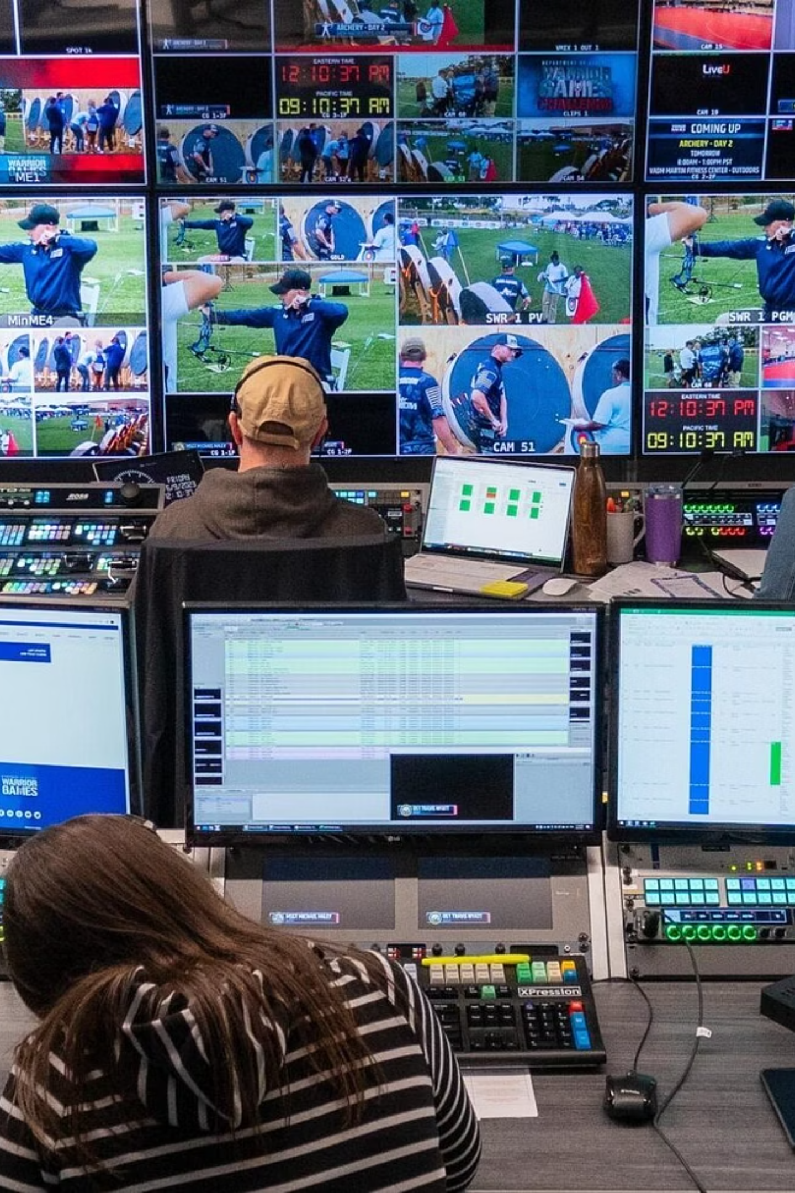

Myriad Uses of AI in Media
Kyle Suess · Bits by the Bay 2026
Practical AI applications across the broadcast media supply chain
Co-founder, Amira Labs · amiralabs.com

Slide 2


The State of AI in 2026
The AI Race is Real
Anthropic $800B · OpenAI $852B · US & China leading
Open-Source Exploded
Google Gemma 4 · Qwen 3.7 · Ollama · Nvidia NeMo
Not Every Service Survives
Sora had $1B deal with Disney, now OpenAI shut the service down
Fastest Adoption Ever
Faster than smartphones, internet, and TV · M&E use projected 25% CAGR over next 5 years

Slide 3
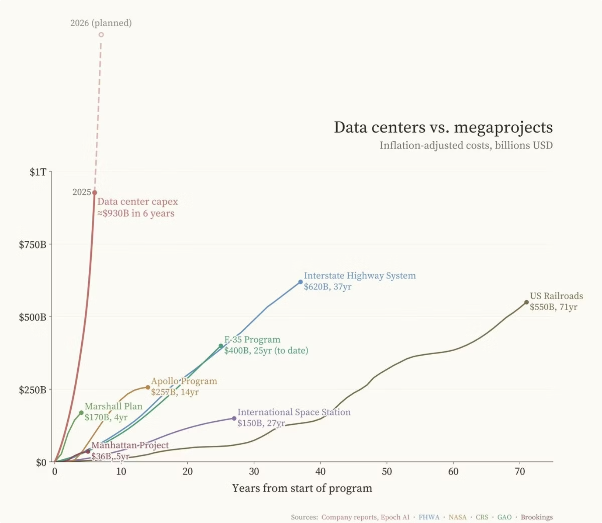

Slide 4
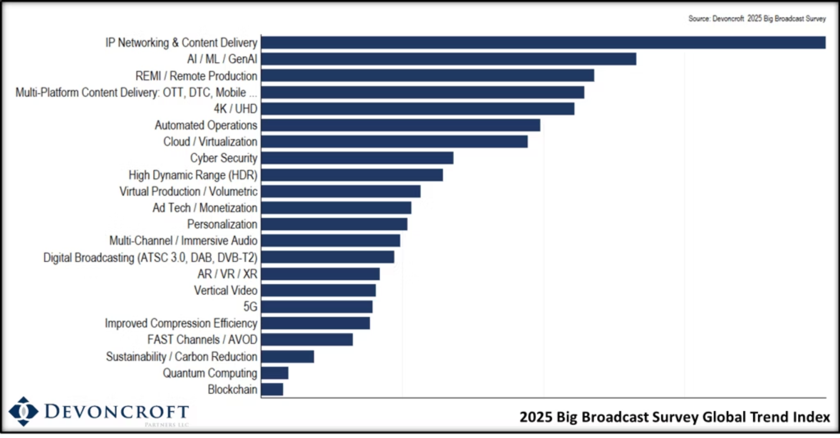

Slide 5

The Media Supply Chain
Acquire
Process
Playout
Ingest
QC
Distribute

Slide 6
Use-Cases by Media Supply Chain Segment

Slide 7
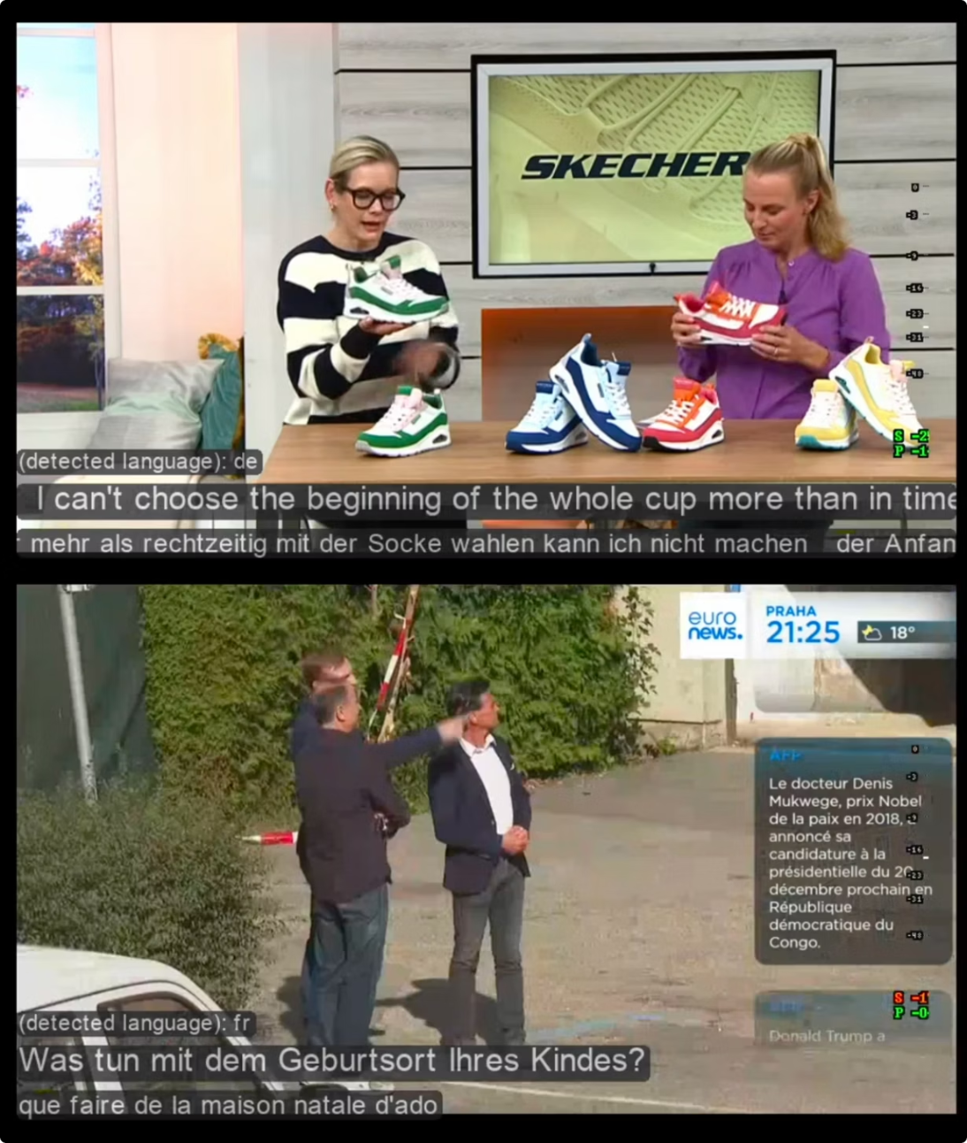

Captioning & Transcription
PROCESS
QC
DISTRIBUTE
The Starting Point for Every Broadcaster
Runs On Your Hardware
Multiple Languages, Real-Time
Whisper, Parakeet, Canary model options. Avoids per-minute bills.
Validates accuracy before distribution.
If you do nothing else, start here. This is the most proven AI use case in broadcast.

Slide 8

Logo & Graphics Detection
QC
PLAYOUT
Logo Presence Verification
Graphics Trigger Validation
Ratings & Watermark Compliance
Check out YOLO and OpenCV

Slide 9
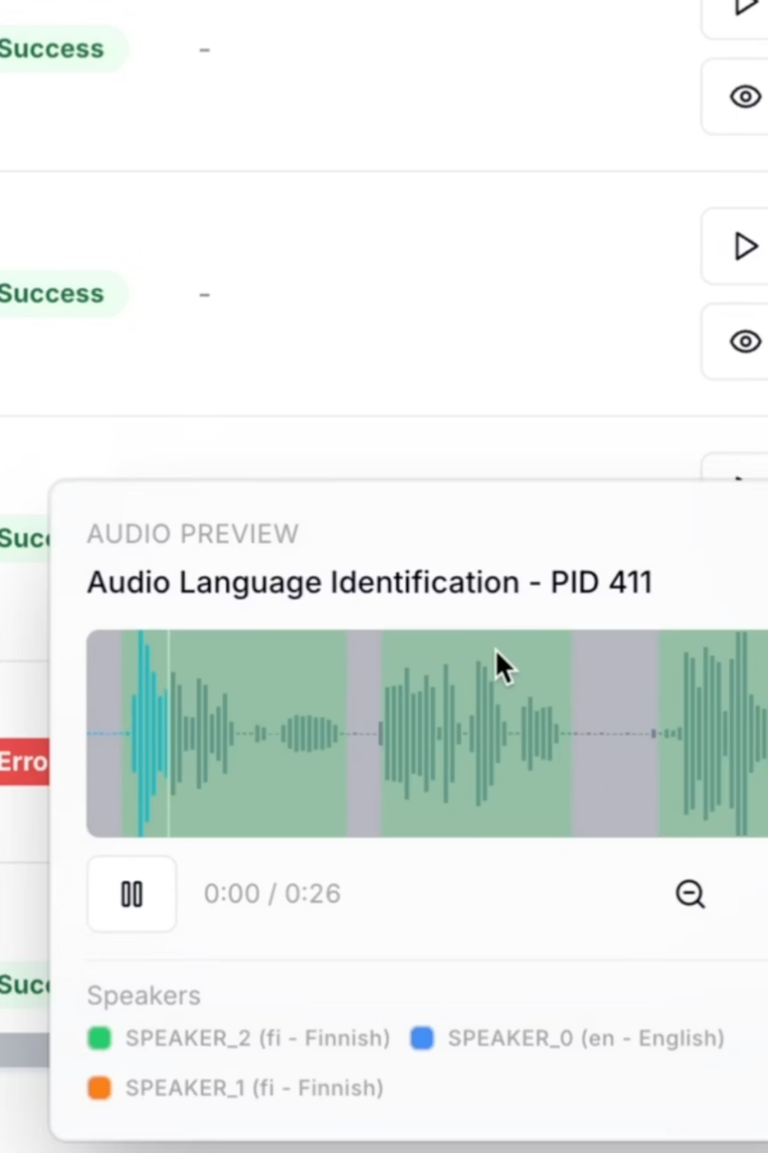
Metadata Tagging & Language ID
INGEST
PROCESS
QC
Auto-Metadata
Language Verification
Tags scenes, topics, and segments automatically. Your MAM filled in seconds — not hours.
Confirms the right language is airing on the right channel. Every feed. Every time.

Slide 10
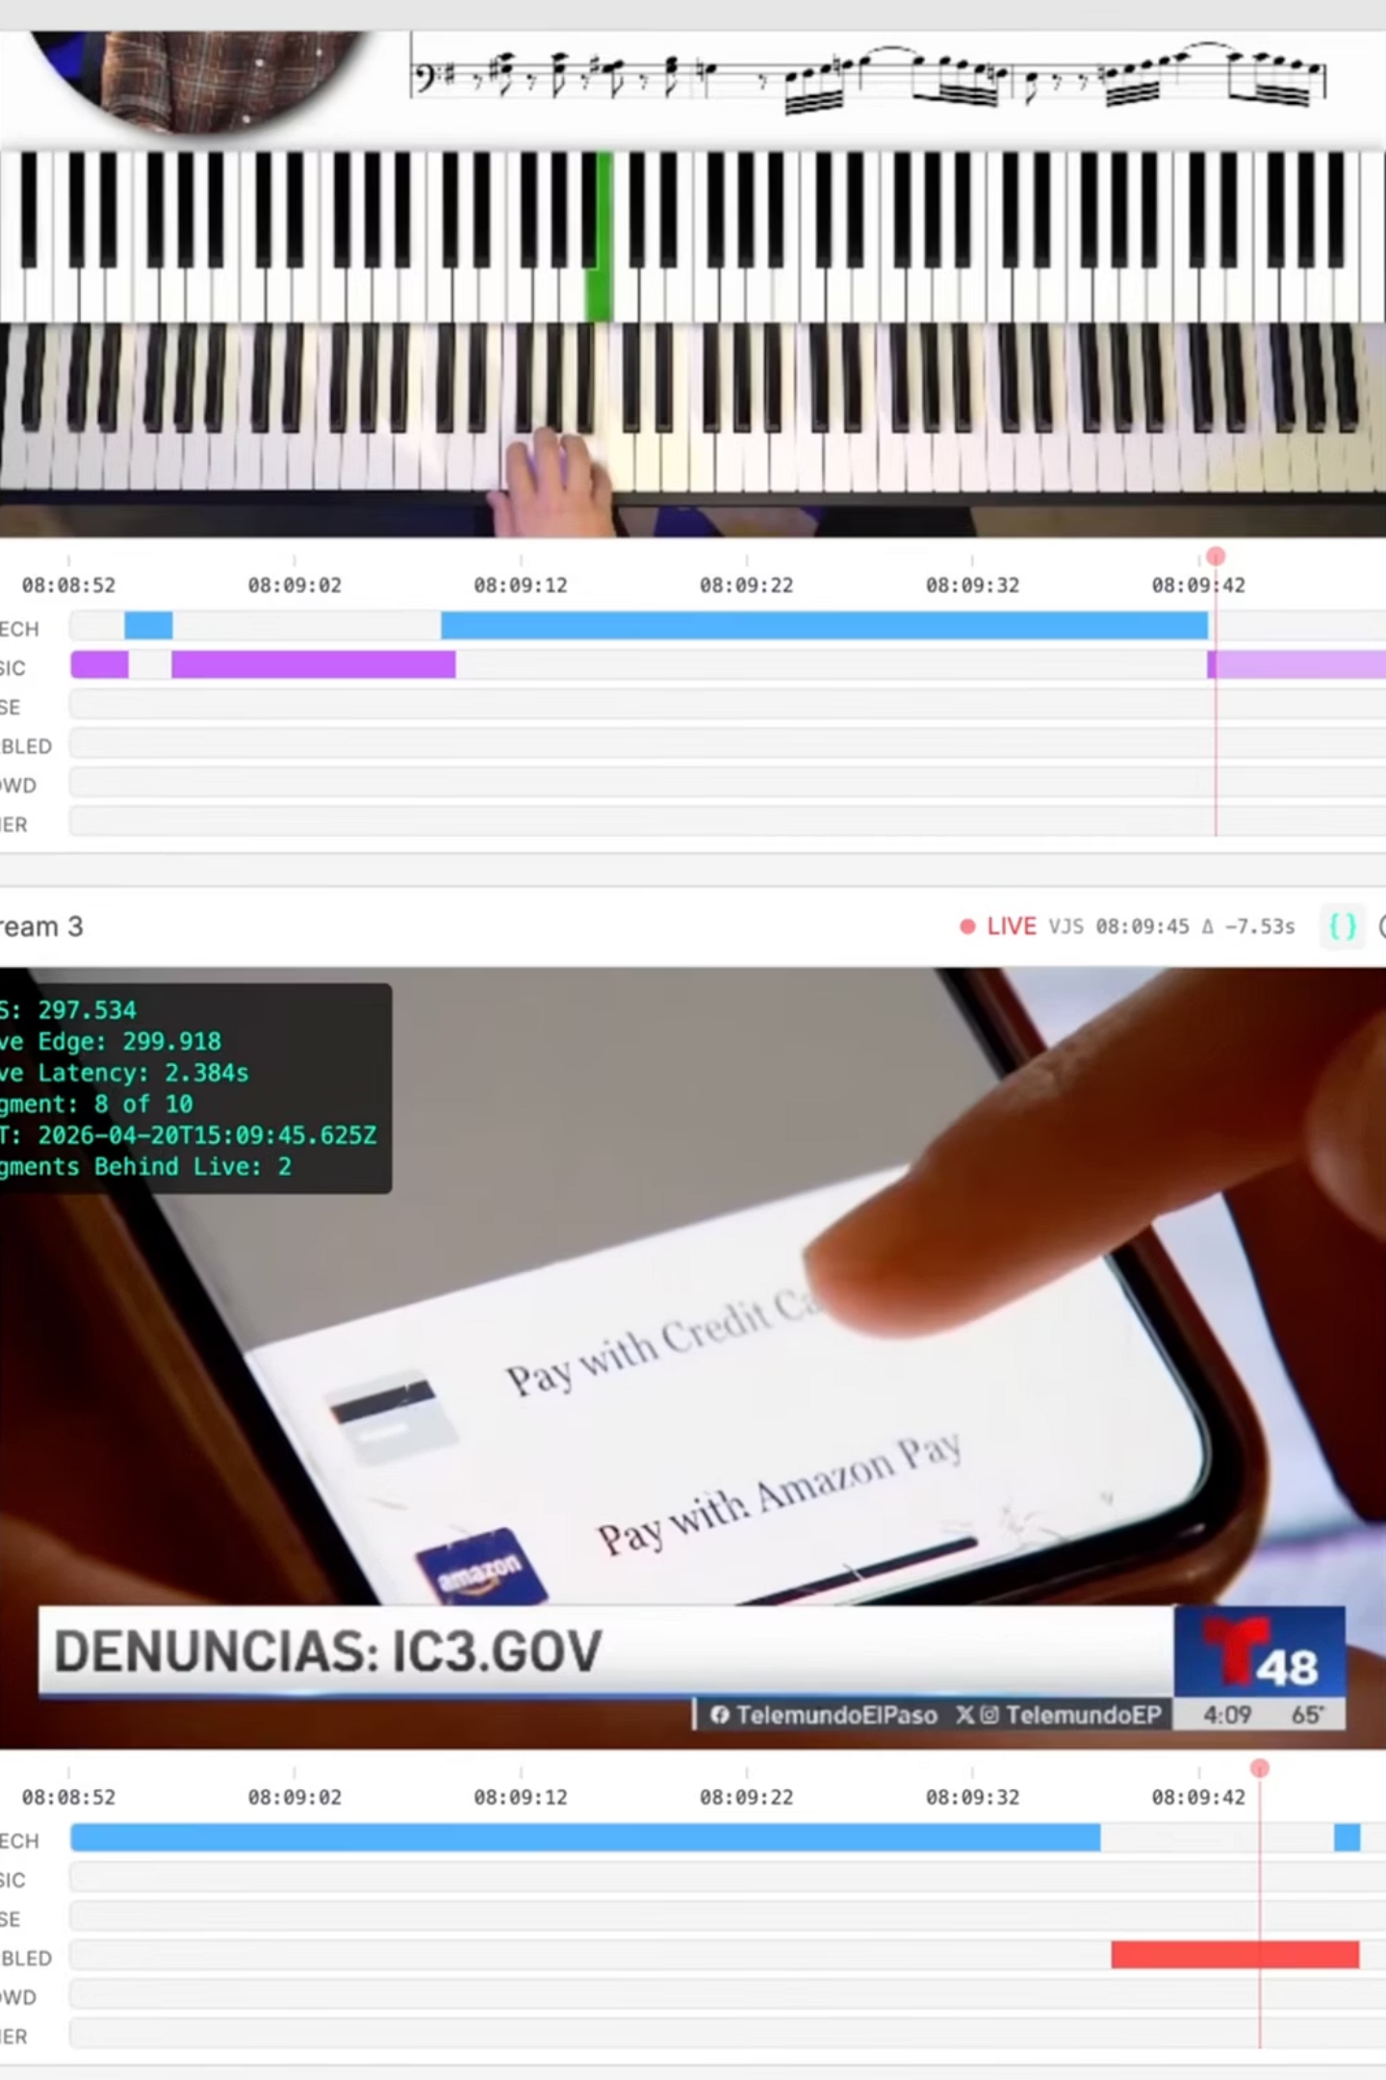
Music Rights Detection & Stem Separation
QC
PLAYOUT
DISTRIBUTE
Like Shazam — Running Locally, 24/7
Audio fingerprinting identifies every track on air — artist, title, timestamp — without sending audio to the cloud.
Sports & Live Events
Model: Meta Demucs
Rights Compliance

Slide 11
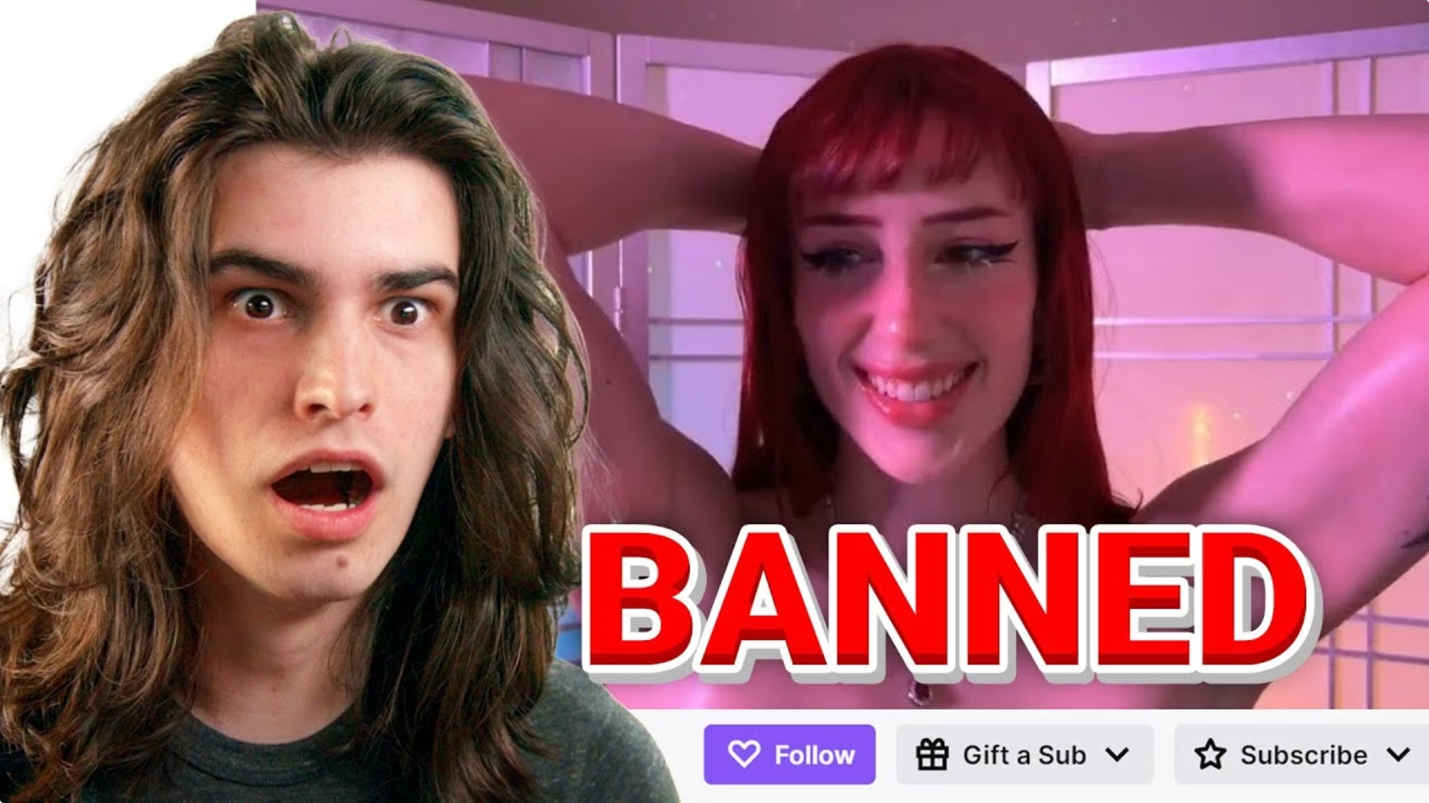

Content & Brand Safety
QC
PLAYOUT
Frame-by-Frame Analysis
Frame-by-Frame
Broadcast-Trained
Instant Enforcement
Check HuggingFace for open moderation models

Slide 12
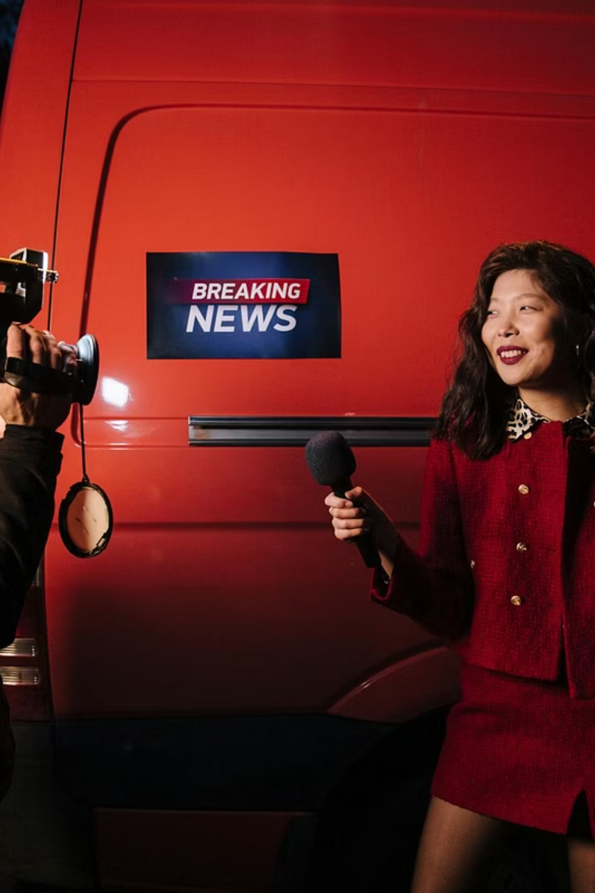
Breaking News Detection
ACQUIRE
PROCESS
DISTRIBUTE
What AI Sees
What Happens
Graphics change
Urgent audio tones
Chyron shifts
Triggers alerts seconds after a story breaks — before your competition knows it's happening.
Feeding RTP, RTSP, SRT, etc into AI pipeline

Slide 13
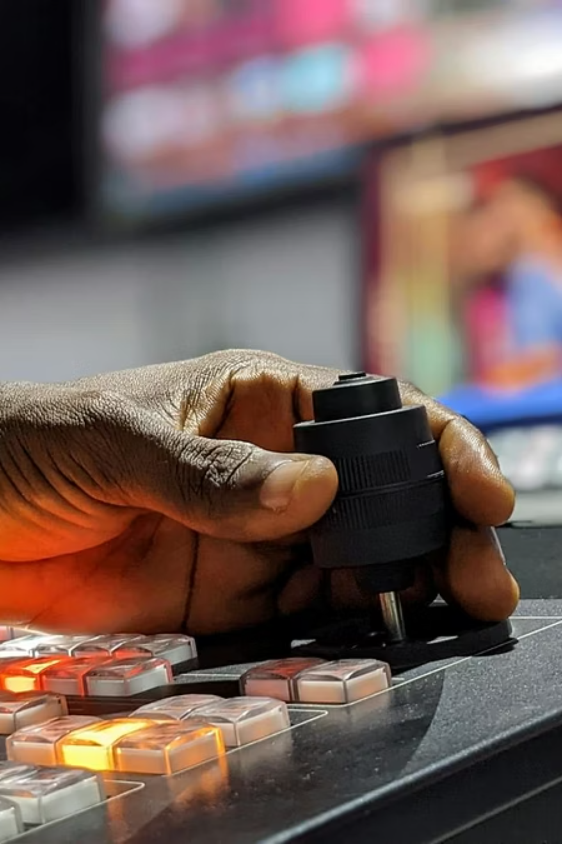
Smart Ad Insertion
PLAYOUT
DISTRIBUTE
Natural Boundaries
SCTE-35 Ready
AI finds scene breaks — no mid-sentence cuts
Triggers standard insertion markers automatically
Also Hot: Dynamic Ad Networks
AI commerce - for buying and selling based on demand

Slide 14

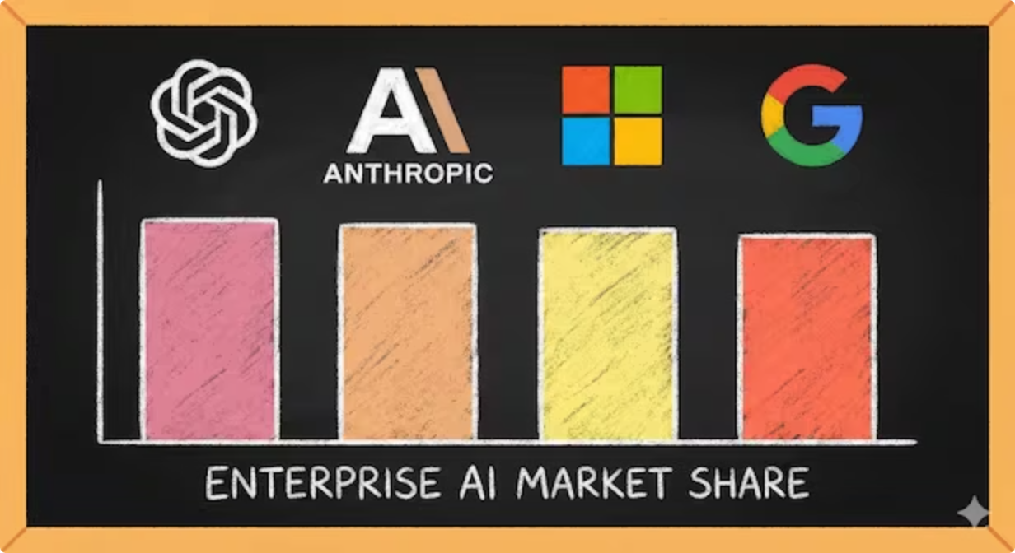
Why "Local AI" Matters
More sustainable long-term
Use what you need when you need it. Split compute and cloud needs in hybrid way.
Less lock-in risk
Fixed hardware. No per-minute API fees. Budget certainty.
Your custom models, your data
No cloud uploads. No third-party access. Full control of your assets.

Slide 15
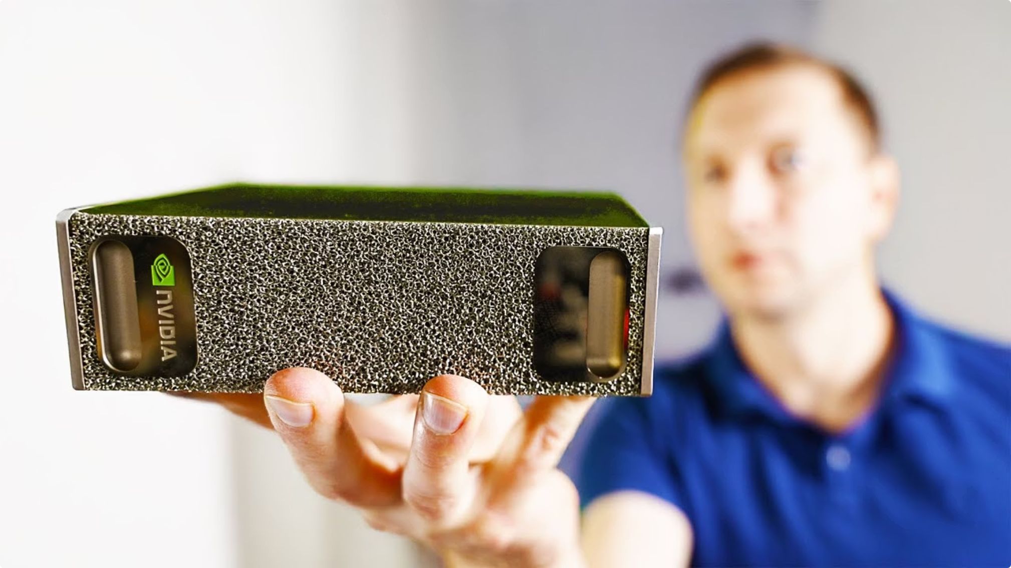
What Runs Locally Today
Speech
Whisper · ASR · single GPU
Vision
YOLO · OCR · NVIDIA T4, L4
Open Models
Google Gemma 4 · Alibaba Qwen 3.7 — free, open source, in your rack

Slide 16
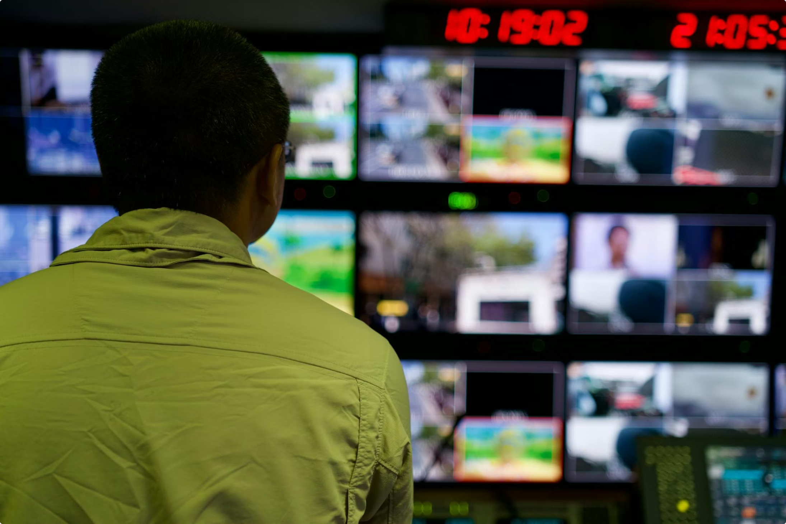
What This Means for Your People
AI Takes Away
Repetitive spot-checks
Manual metadata entry
Error-prone logging
Your Team Does Instead
Judgment calls & creative decisions
Crisis response
30 years of experience no AI has
"Your operators don't get replaced. They get superpowers."

Slide 17

Thank you!
amiralabs.com
Kyle Suess
kyle@amiralabs.com
Thank you to Bits by the Bay!

